Slide 1
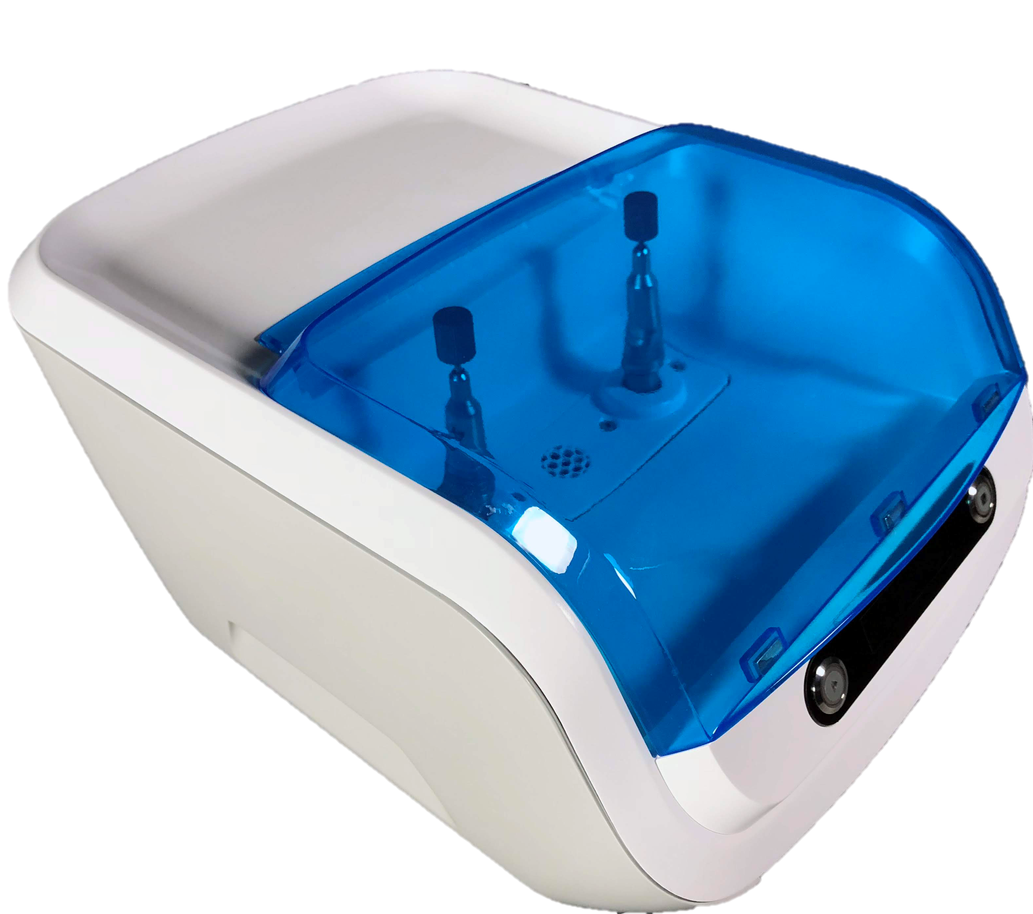
Handpiece Cleaner/Lubricator Prototyping at M3 Design
Siddharth Kurwa
skurwa.github.io

Slide 2
Agenda
About Me
Project Background
Design Process
Hardware Selection
Low-Resolution Prototype
Functional Prototype
Looks-Like/Works-Like Prototype
Outcome
Questions

Slide 3
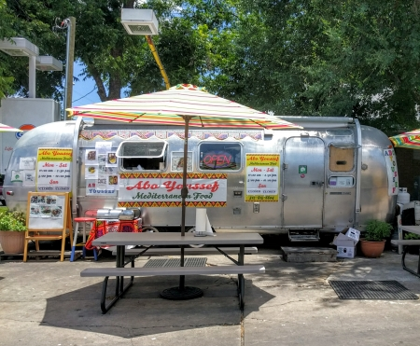

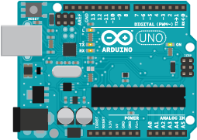
A Few of My Favorite Things
Mediterranean Food
Zion National Park
Tinkering
About Me
Project Background
Hardware Selection
Low-Res Prototype
Functional Prototype
Looks-Like/Works-Like
Outcome

Slide 4
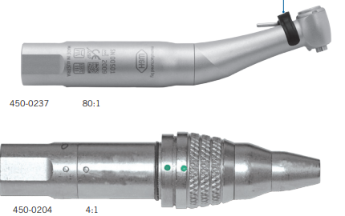
Project Background
Client Need
Field support for failed medical handpieces is expensive
Handpiece cycle life reduced by poor manual maintenance
Problem Statement
Design and build a cleaning/lubricating system to simplify handpiece maintenance
Timeline
1.5 months
Team Roles
2 ME – fluid system design, CAD, mechanical prototype
1 ID - user workflow, product aesthetic
1 EE/ME - verification, support, debug
1 EE - hardware selection, software development, system testing
Client’s surgical handpiece products.
About Me
Project Background
Hardware Selection
Low-Res Prototype
Functional Prototype
Looks-Like/Works-Like
Outcome

Slide 5
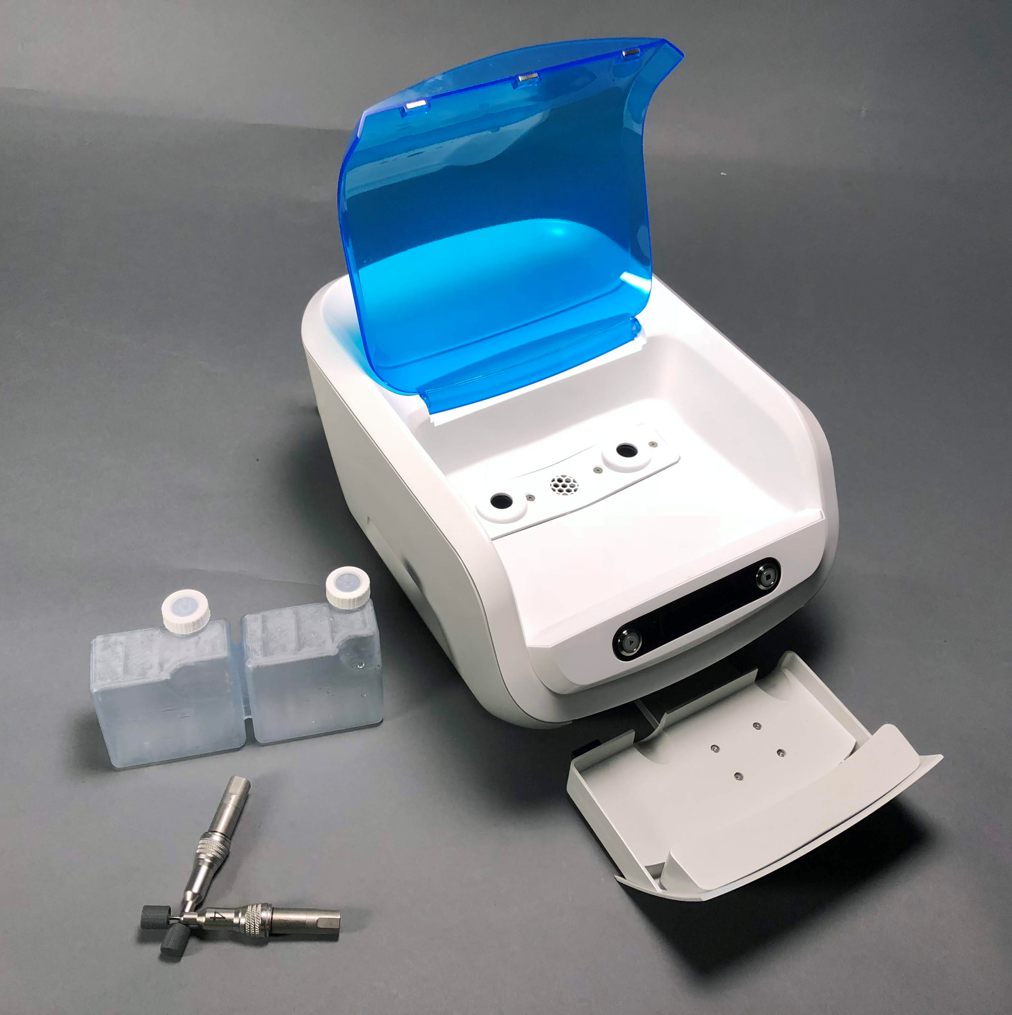
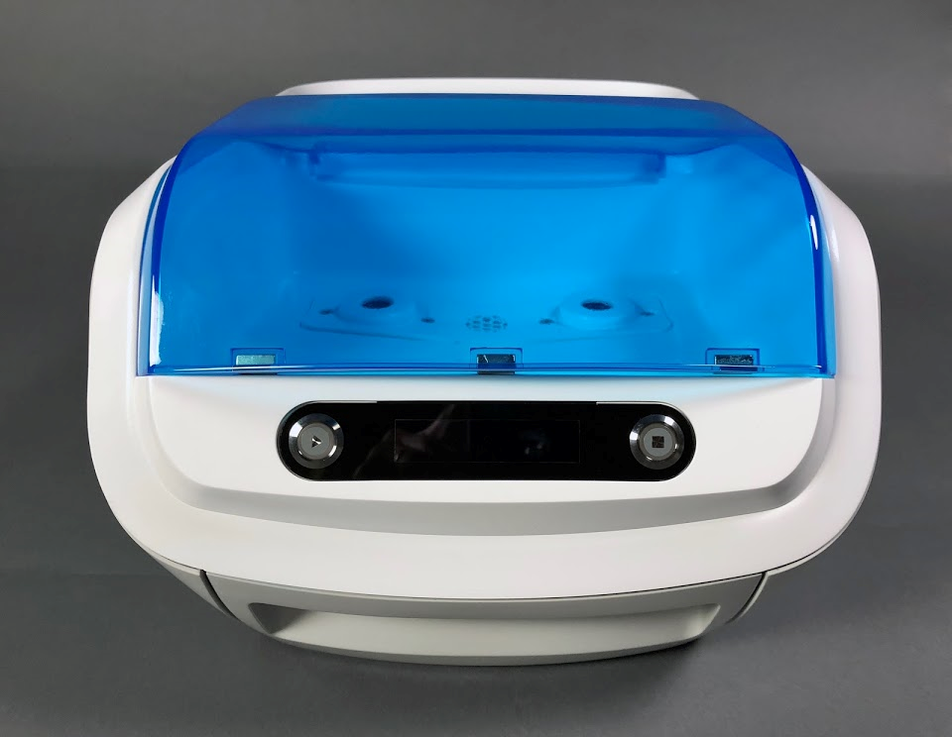
Product Externals
Door
Pushbuttons
Cleaner and lubricant cartridges
Handpieces
Cartridge tray
OLED display
About Me
Project Background
Hardware Selection
Low-Res Prototype
Functional Prototype
Looks-Like/Works-Like
Outcome

Slide 6
My Scope
Select, design, and build the electronics and control system to meet mechanical and industrial design requirements in a 1.5 month timeline.
About Me
Project Background
Hardware Selection
Low-Res Prototype
Functional Prototype
Looks-Like/Works-Like
Outcome

Slide 7
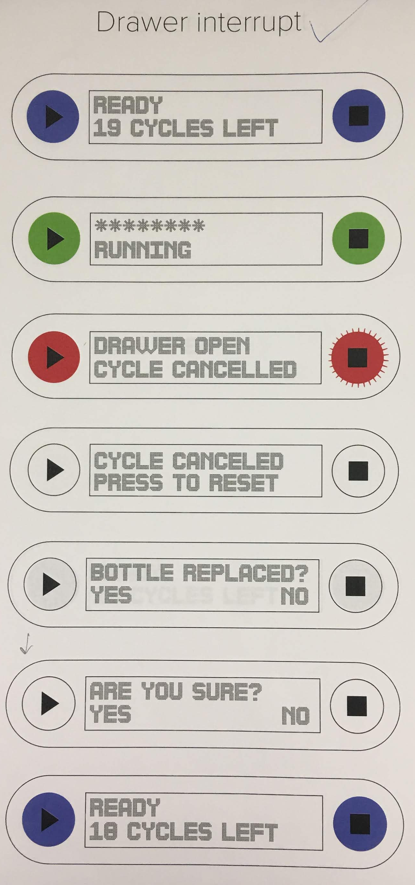
Requirements
Table of design requirements.
Source | Type | Requirement
Industrial Design | Sensing | Detect open/closed door
 | Sensing | Detect open/closed drawer
 | UI | OLED character display
 | UI | 2 pushbuttons
 | UX | 10 user workflow maps
Mechanical | Sensing | Detect tank overflow
 | Controls | Satisfy pump pressure/flow operating conditions
 | Volume | Fit within 12” x 4” x 6” volume
User workflow map.
About Me
Project Background
Hardware Selection
Low-Res Prototype
Functional Prototype
Looks-Like/Works-Like
Outcome

Slide 8
Process
Hardware Selection
Low-Res Prototype
Functional Prototype
Looks-Like, Works-Like Prototype
Identify possible hardware options.
Bench test components to verify viability.
Build and test client deliverable.
Integrate subsystems to verify interaction.
About Me
Project Background
Hardware Selection
Low-Res Prototype
Functional Prototype
Looks-Like/Works-Like
Outcome

Slide 9
Hardware Selection
About Me
Project Background
Hardware Selection
Low-Res Prototype
Functional Prototype
Looks-Like/Works-Like
Outcome

Slide 10
Sensor Survey
Open/closed door and drawer
Considered detent and reed switches – quickly chose reed switches for smaller package size
Liquid level switch
Researched sensing principles (ultrasonic, capacitive, optical, pressure, magnetic) and found several options – narrowed down to below list
Comparison of liquid level switch solutions.
Working Principle | Source | Lead Time | Pros | Cons
Capacitive | DFRobot | 1-2 weeks | Cost; non-contact; package size | Limited resources; lead time
Capacitive | Carlo Gavazzi | 1 day | Non-contact; lead time; support | Cost; package size
Optical | Sparkfun | 1 day | Cost; lead time; package size | Contact
About Me
Project Background
Hardware Selection
Low-Res Prototype
Functional Prototype
Looks-Like/Works-Like
Outcome

Slide 11
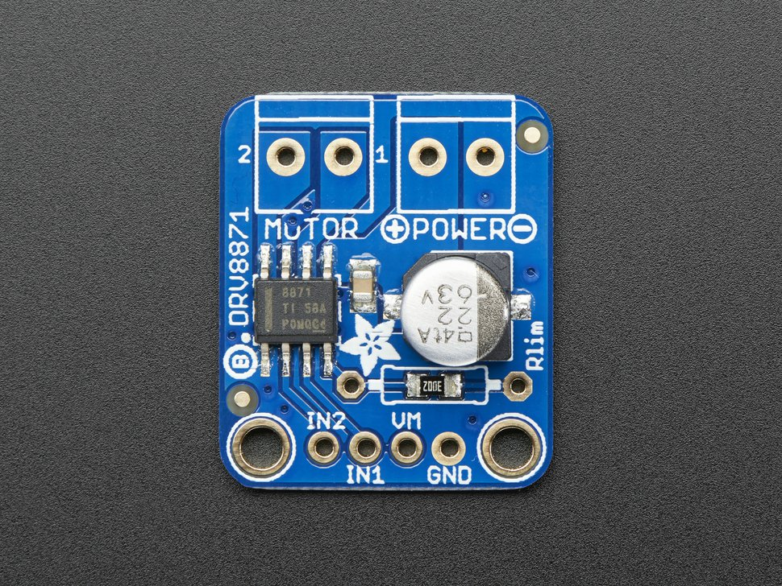
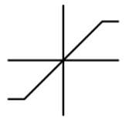
Pump Control Solution
Pump operating condition requirements
Open handpieces: 30 GPH, <4 psi
Restrictive handpieces: 0 GPH, <9 psi
Tested pump characteristics without control
Open flow: 30 GPH, 3.6 psi
Choked flow: 0 GPH, 16 psi
Made physical system model to identify control need
Motor driver to satisfy requirement
Sense resistor controls current limiting
Controller saturates input current
Input current
K₁
Motor torque
K₂
Output pressure head
Open-loop control model of pump.
DRV8871 motor driver.
About Me
Project Background
Hardware Selection
Low-Res Prototype
Functional Prototype
Looks-Like/Works-Like
Outcome

Slide 12
Hardware Selection
Low-Res Prototype
About Me
Project Background
Hardware Selection
Low-Res Prototype
Functional Prototype
Looks-Like/Works-Like
Outcome

Slide 13
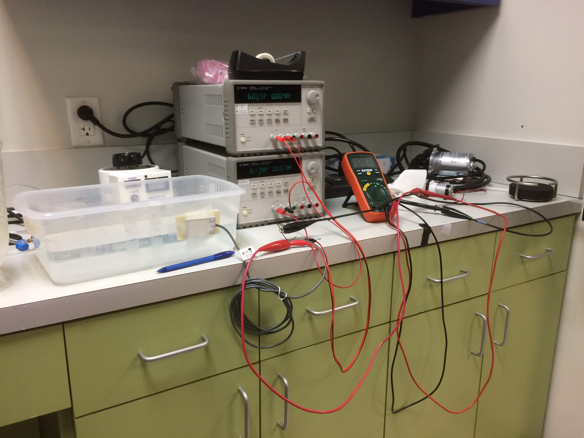
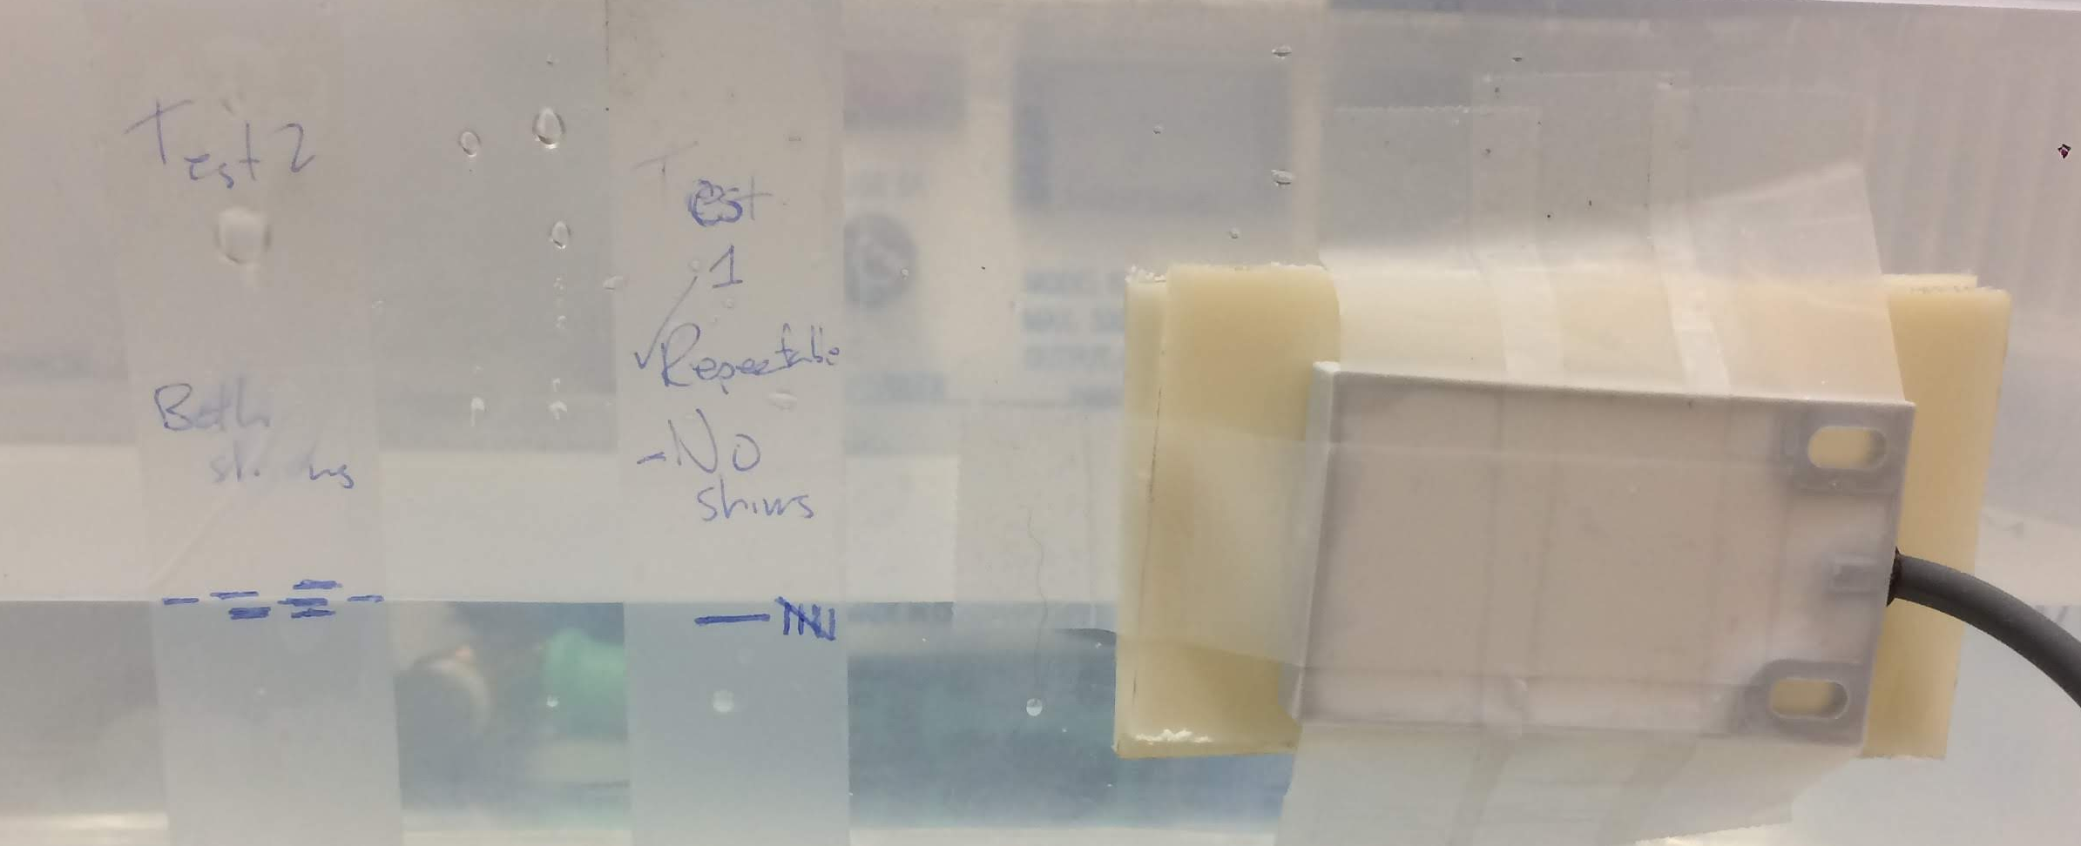
Sensor Function Checking
¼” shim
No shim
Carlo Gavazzi sensor
0.1” repeatability range
Level sensor bench test setup.
Test results.
0.1” repeatability acceptable with margin based on tank CAD and projected sensor position
About Me
Project Background
Hardware Selection
Low-Res Prototype
Functional Prototype
Looks-Like/Works-Like
Outcome

Slide 14
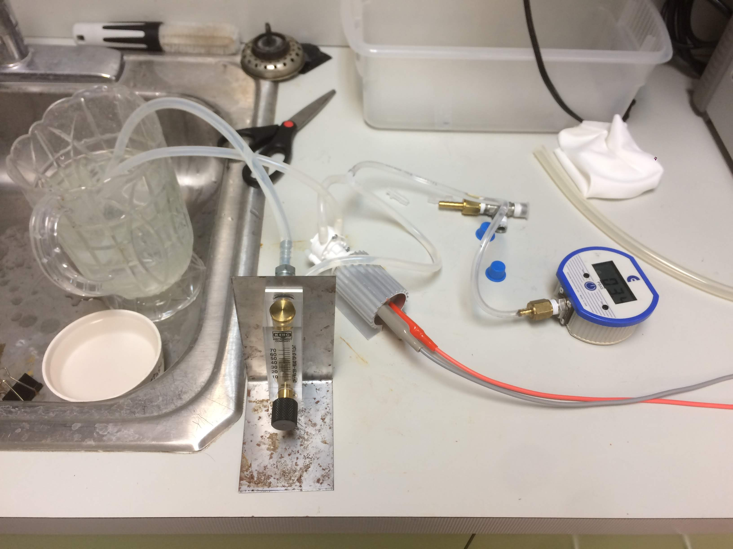
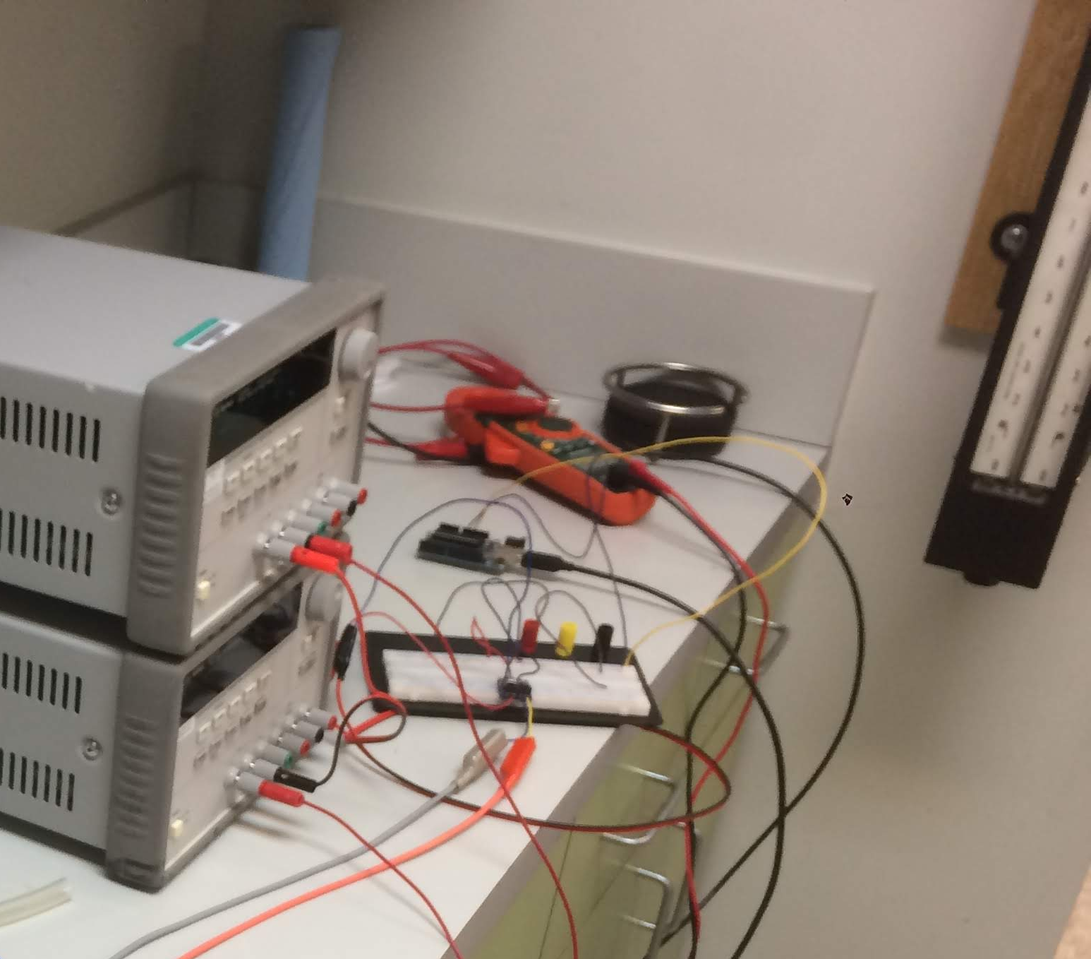

Pump Control Testing
Iteratively determined current sense resistor to meet pressure requirements
Provided empirical model:${ R}_{sense}= \frac{64k}{I_{lim}}$
Pump
Pressure transducer
Flowmeter
Motor driver
Choke valve
Pump measurement setup.
Motor driver outputs.
About Me
Project Background
Hardware Selection
Low-Res Prototype
Functional Prototype
Looks-Like/Works-Like
Outcome

Slide 15
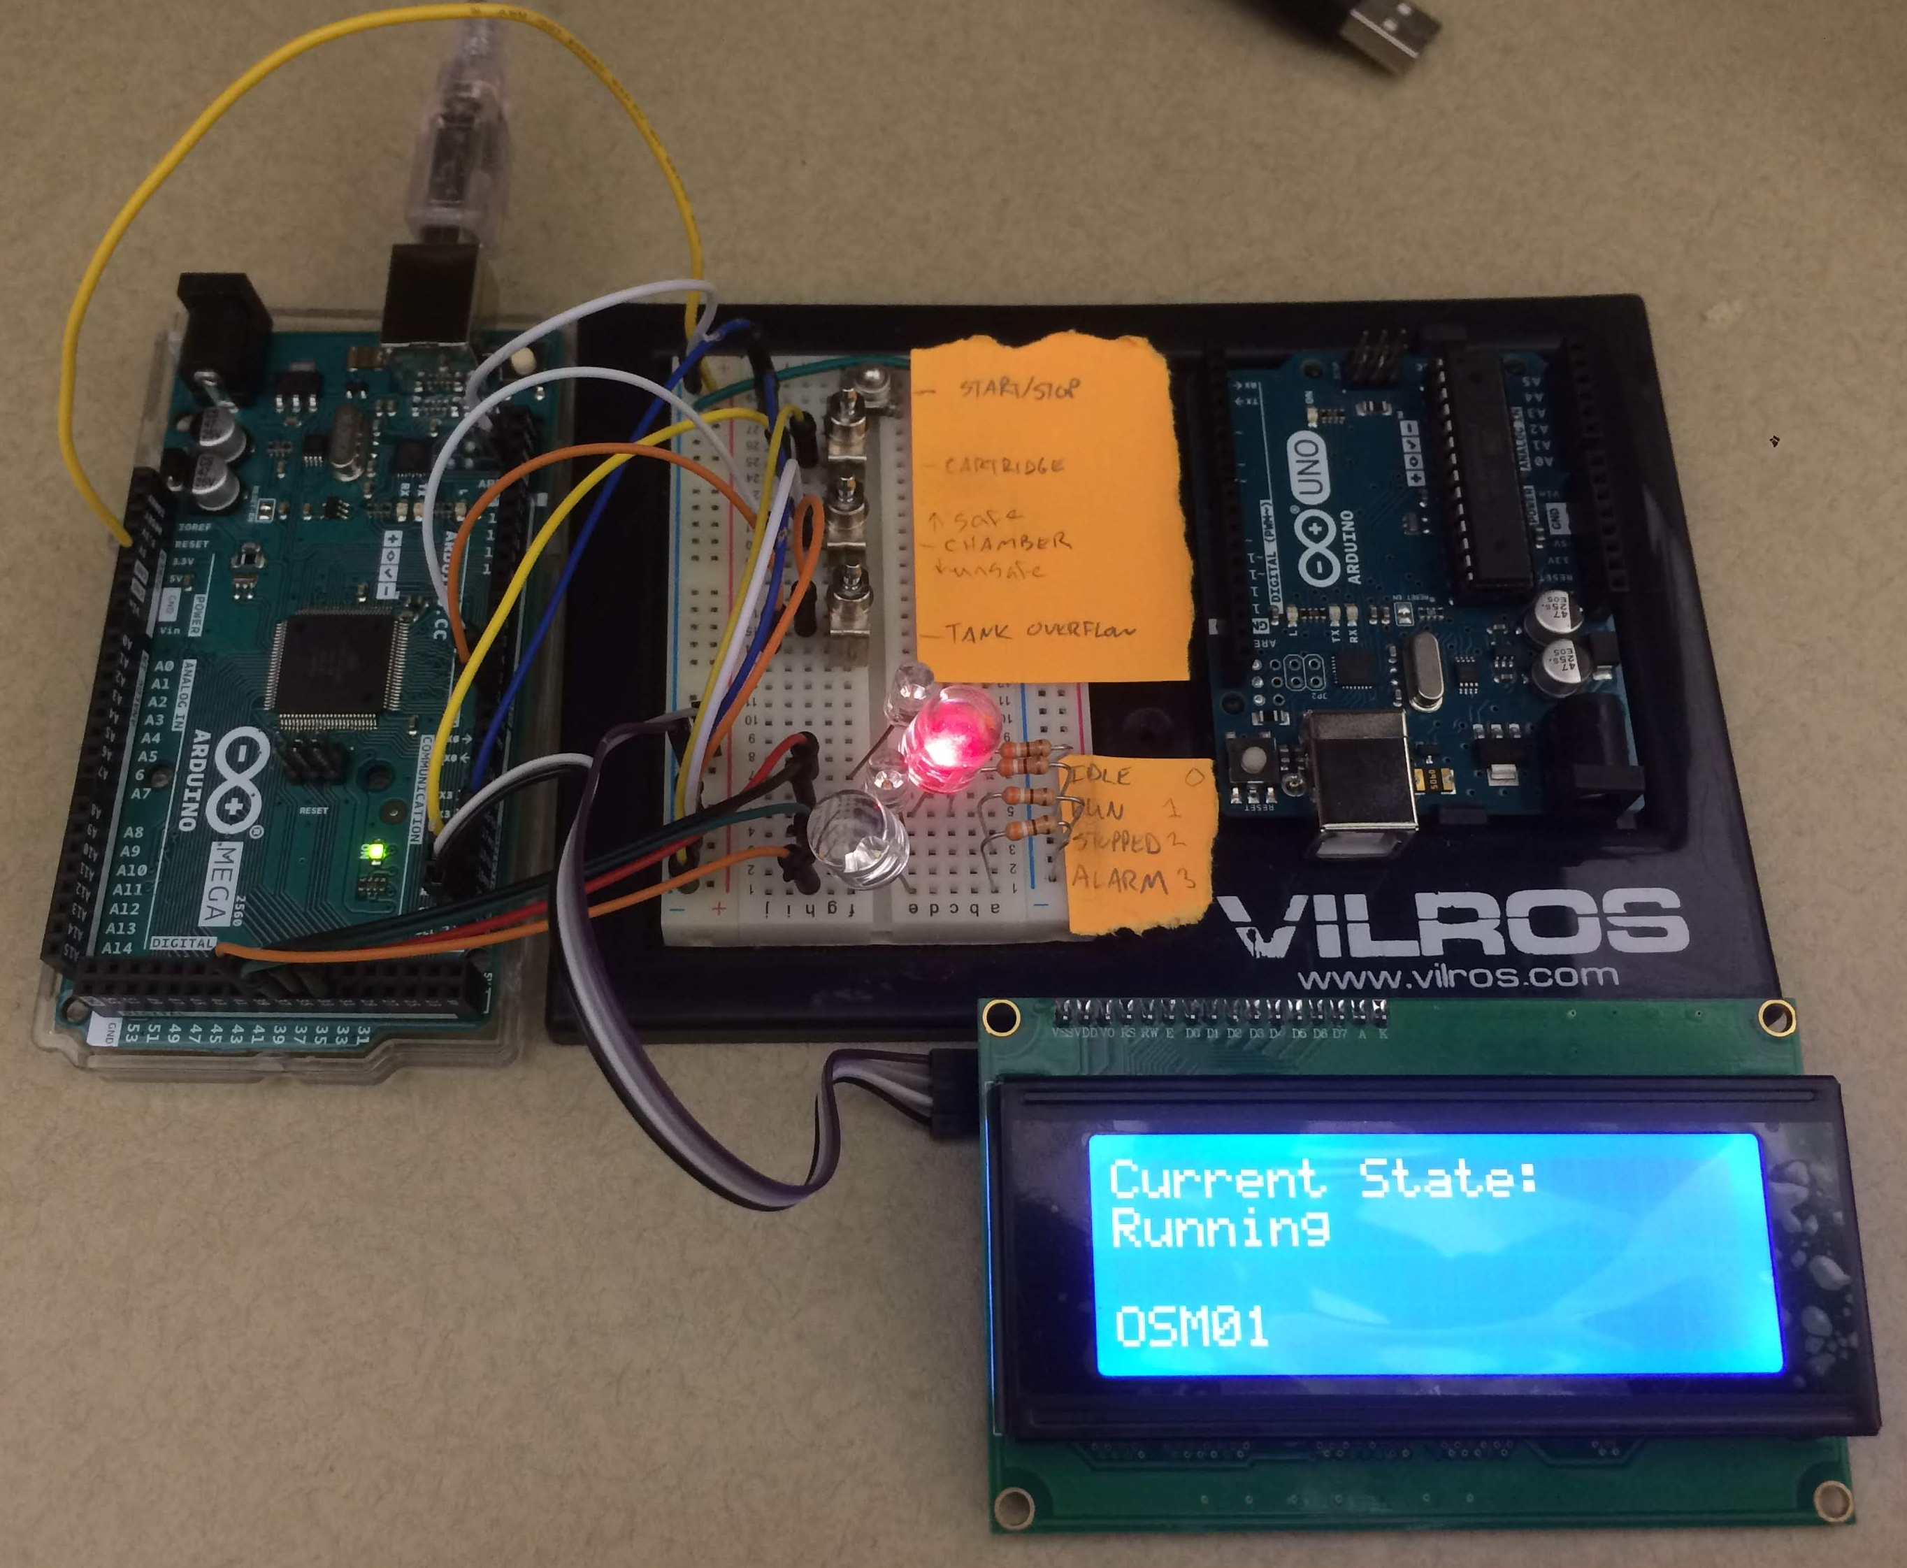
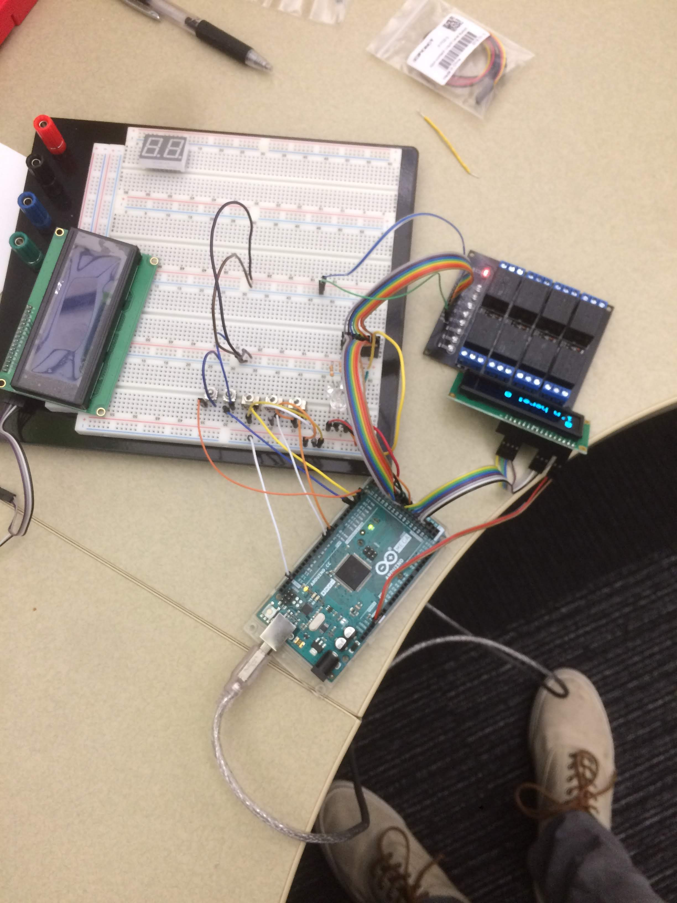
State Machine Software
Toggle switches
(sensors)
Arduino microcontroller for digital IO
Used simple components to simulate physical system
LEDs
LCD display
Initial prototype to drive LED output.
Previous state
Relay module
Idle LED output
OLED
display
Pushbutton interrupts
State
Run LED output
State selector
Toggle switch interrupts
Alarm LED output
Finished LED output
Elapsed time
Foundational state machine architecture.
Incrementally added components.
About Me
Project Background
Hardware Selection
Low-Res Prototype
Functional Prototype
Looks-Like/Works-Like
Outcome

Slide 16
Hardware Selection
Low-Res Prototype
Functional Prototype
About Me
Project Background
Hardware Selection
Low-Res Prototype
Functional Prototype
Looks-Like/Works-Like
Outcome

Slide 17
State Machine Expansion
Hierarchical state machine to control sequencing of run-time processes
Handled nominal and edge cases with 11 states and event/interrupt hierarchy
Ex. edge case: enter run, trip door alarm, trip drawer alarm
Previous state
Idle output
Open drain
Pushbutton interrupts
Door alarm output
Close drain
State selector, process selector
State
Process
Drawer alarm output
Add cleaner
Sensor interrupts
…
…
Elapsed time
Run
Pump fluid
Robust state machine architecture.
About Me
Project Background
Hardware Selection
Low-Res Prototype
Functional Prototype
Looks-Like/Works-Like
Outcome

Slide 18
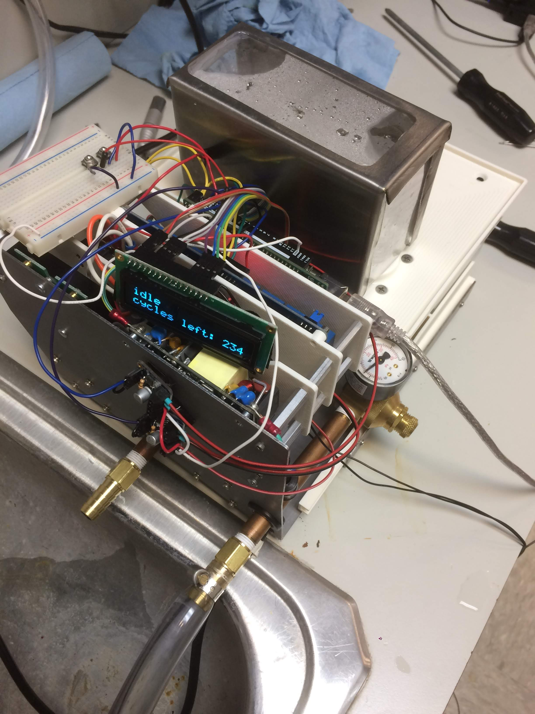
System Integration
Validated pump performance in actual system
Supported ME in tuning process function timing and sequence
Drain tank
Fill tank
Add cleaner
Run agitator
Pump fluid
Drain tank
Fill tank
Add lubricant
Run agitator
Pump fluid
Drain tank
Determined process sequence.
Functional prototype.
About Me
Project Background
Hardware Selection
Low-Res Prototype
Functional Prototype
Looks-Like/Works-Like
Outcome

Slide 19
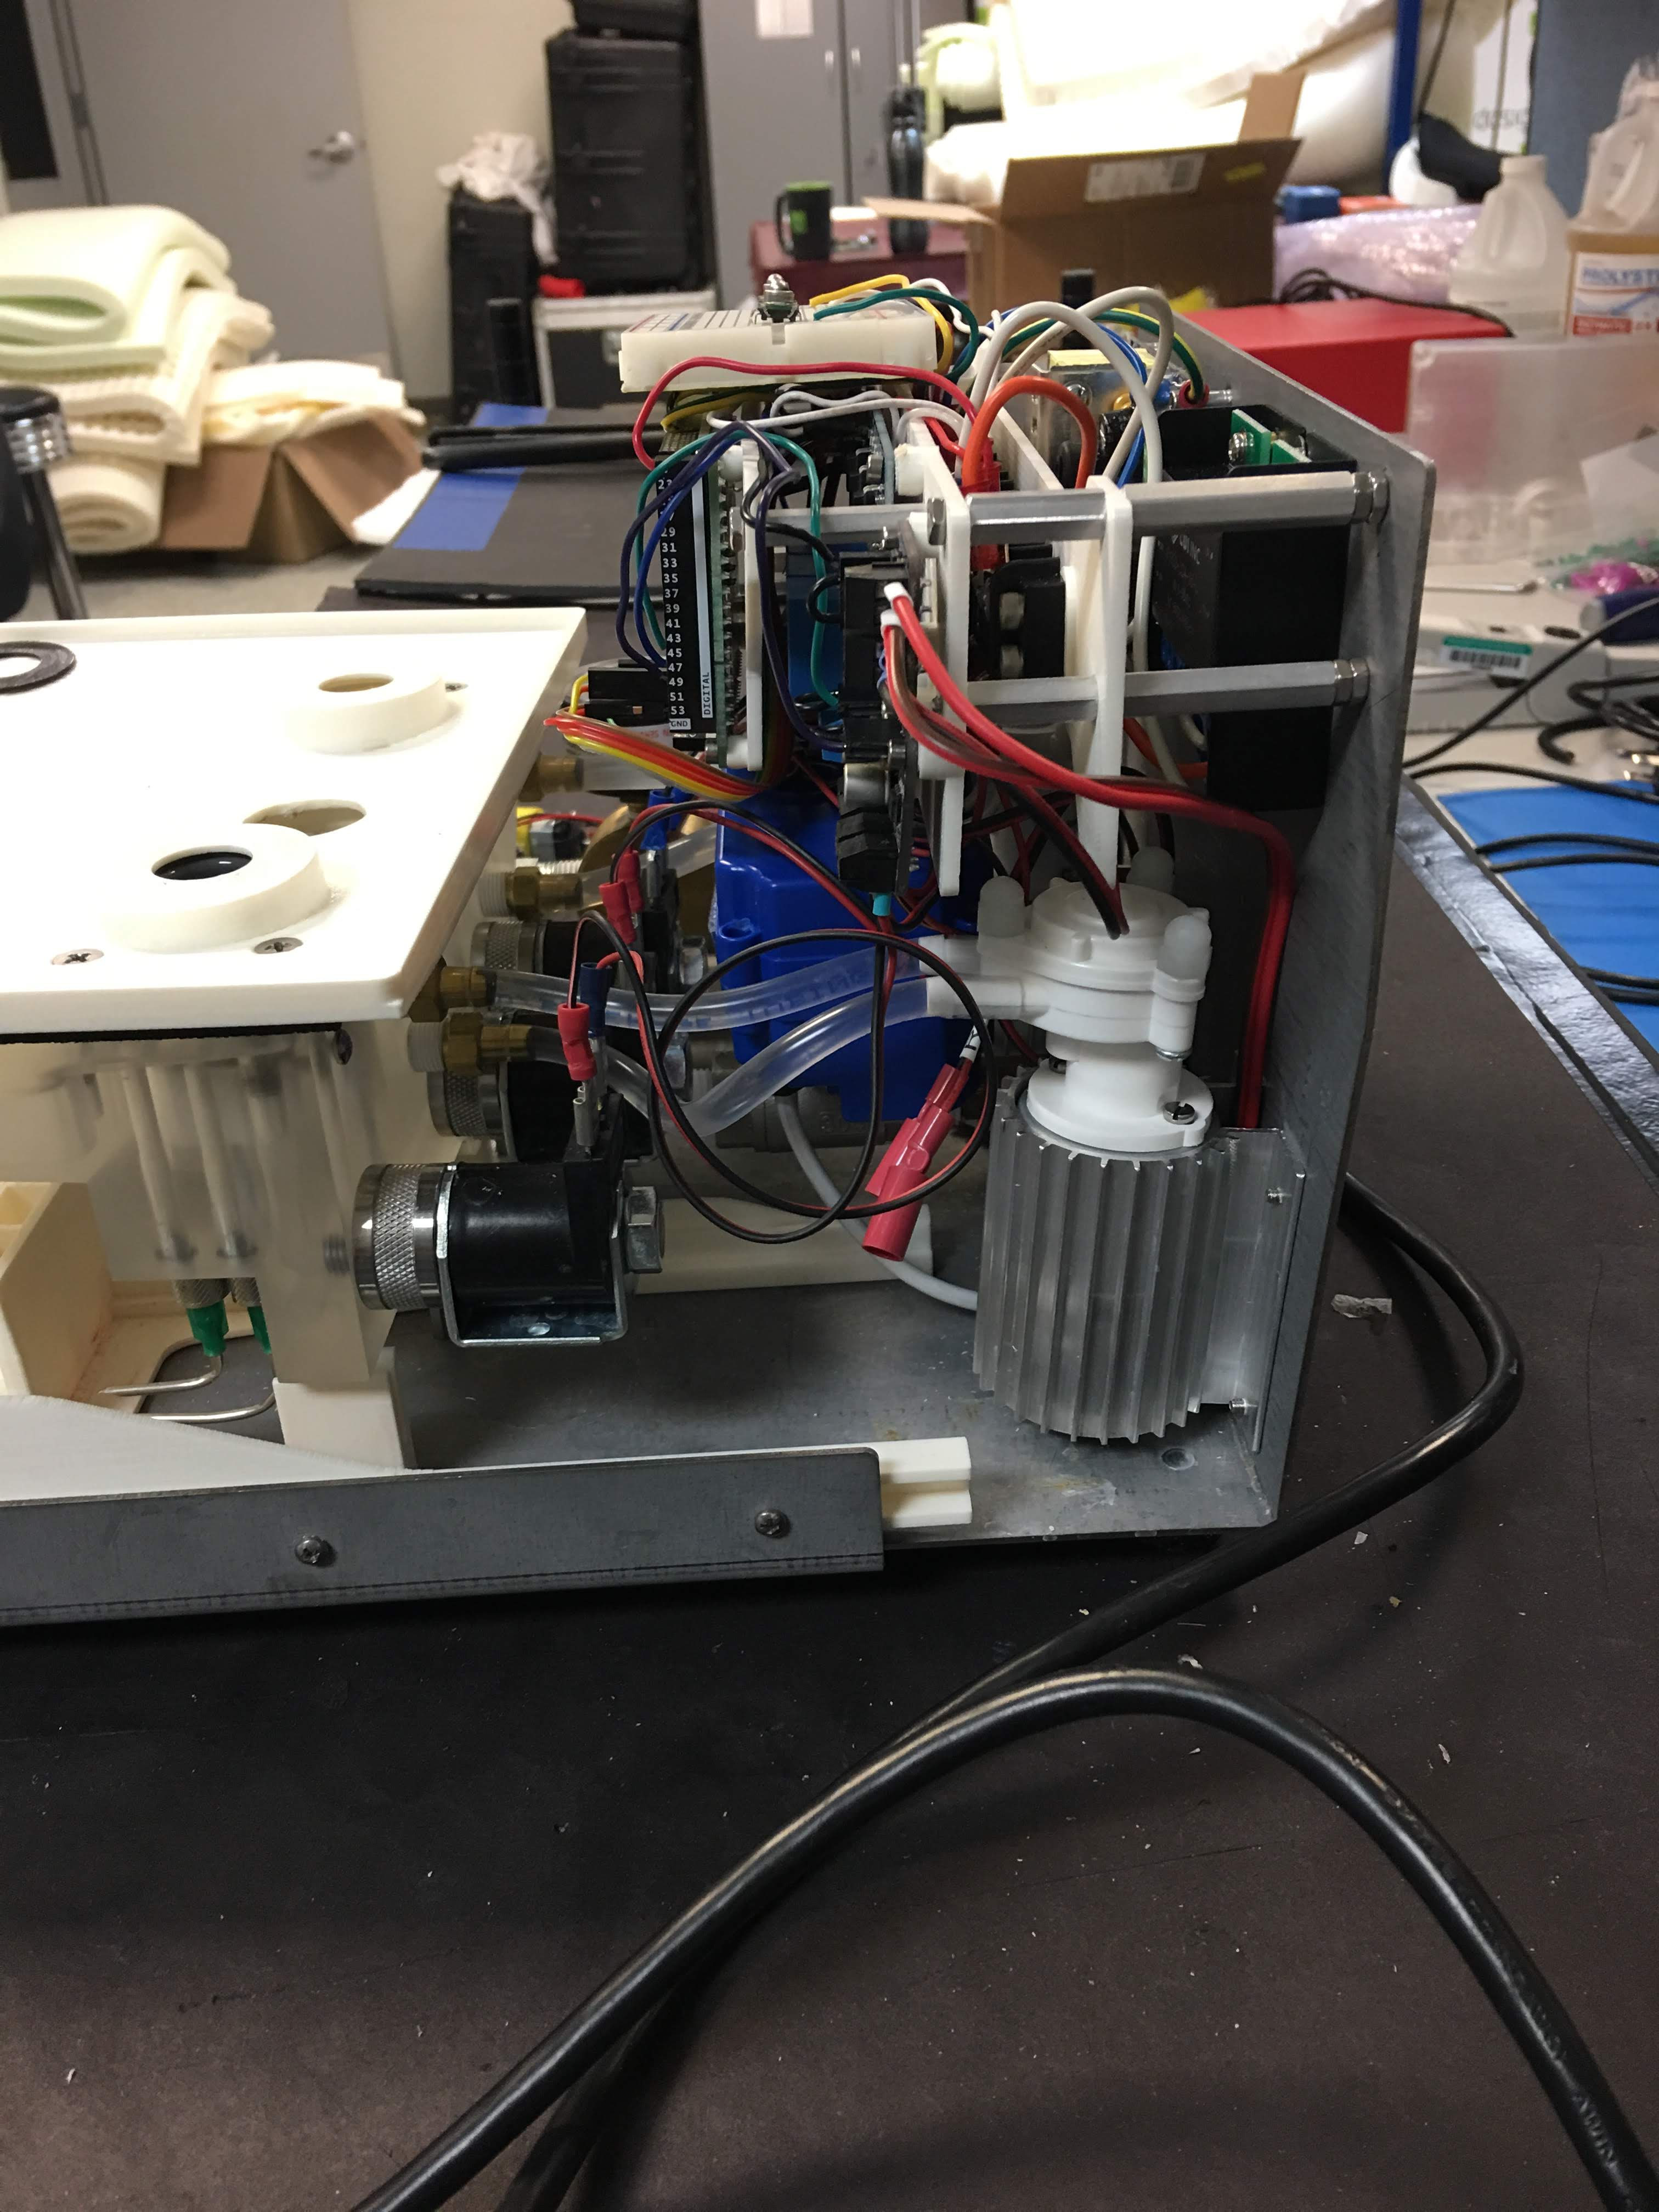
System Debug
Solenoid valve
Issue
Solenoid valves overheating – melting risk to acrylic manifold/reservoir
Context
Solenoid directly connected to power supply, bang-bang control
Root Cause Analysis
Found solenoid valve power rating on spec sheet (7W)
Estimated power dissipation (16W) based on winding resistance
Solutions
Limit solenoid valve current draw
Add in-series resistance – cheaper but slower
Swap relay to motor driver with current limiting feature – immediate but more expensive
Acrylic manifold
Solenoid valve and acrylic manifold interface.
About Me
Project Background
Hardware Selection
Low-Res Prototype
Functional Prototype
Looks-Like/Works-Like
Outcome

Slide 20
Hardware Selection
Low-Res Prototype
Functional Prototype
Looks-Like, Works-Like Prototype
About Me
Project Background
Hardware Selection
Low-Res Prototype
Functional Prototype
Looks-Like/Works-Like
Outcome

Slide 21
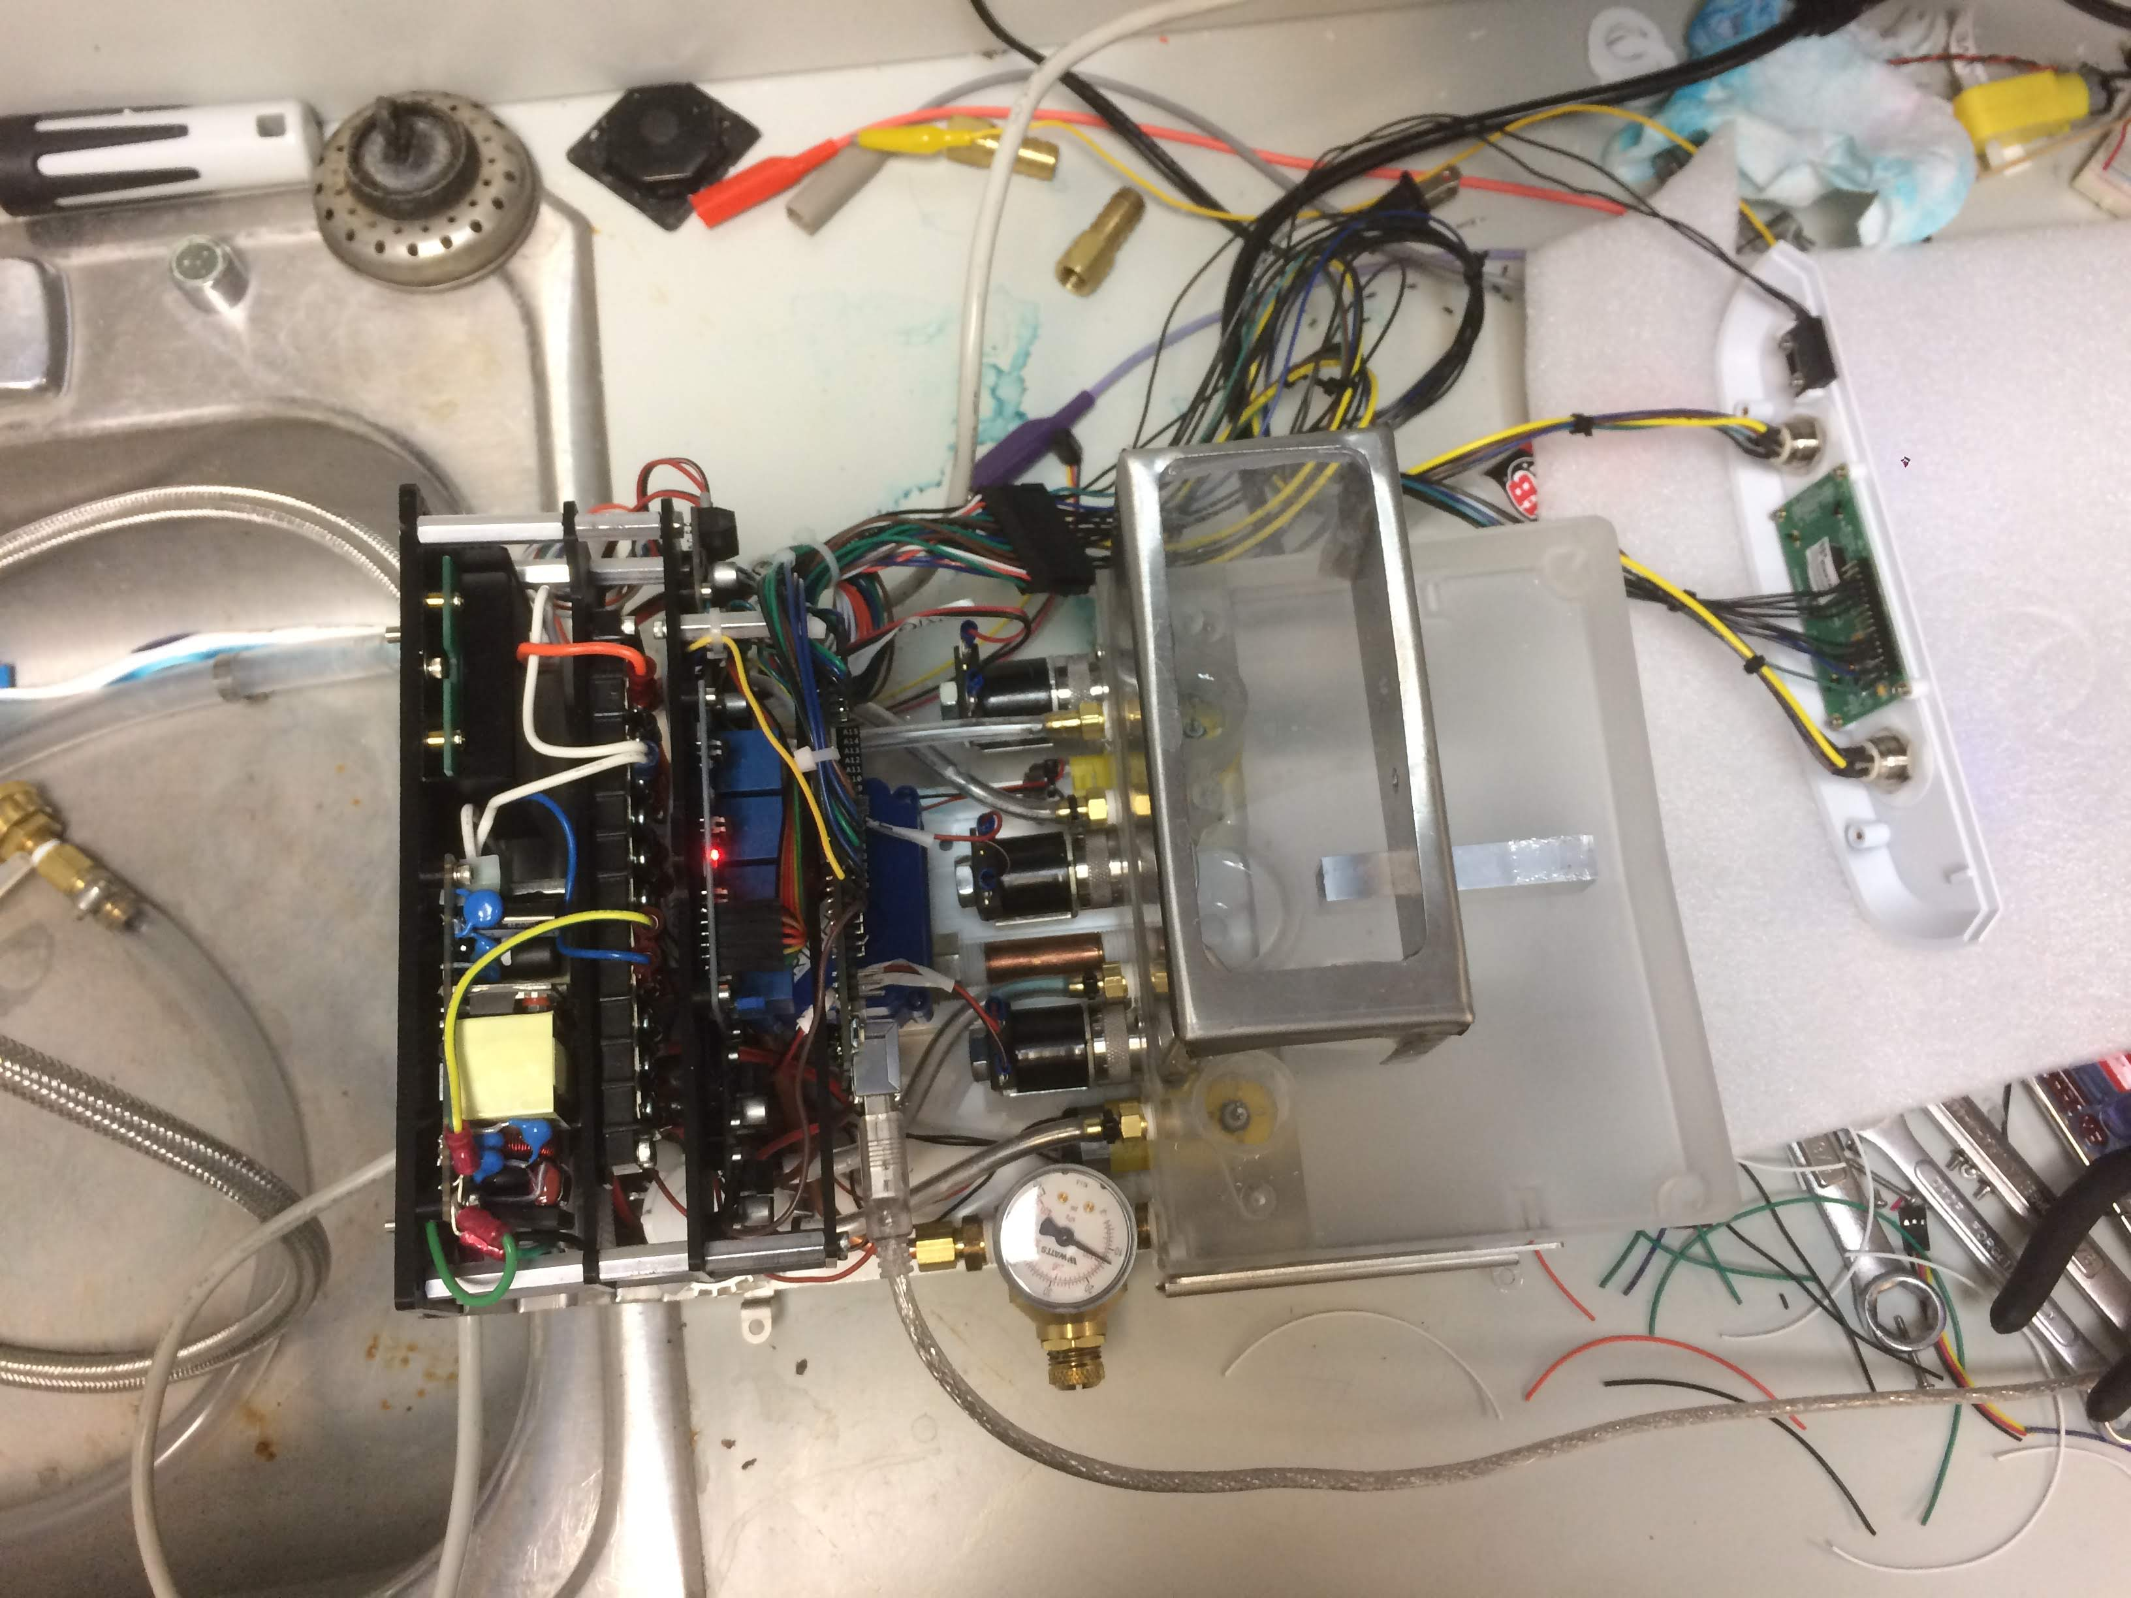
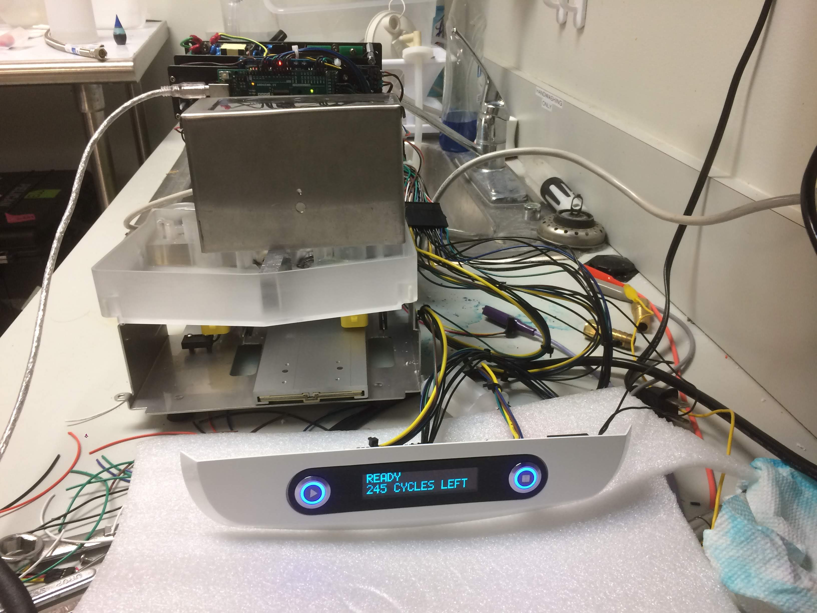
Looks-Like, Works-Like Prototype
Incorporated sensors, UI features, and reliable connections
Reed switch
Molex connectors
User interface
Adding final electronics features to system.
Powering on system with finalized components.
About Me
Project Background
Hardware Selection
Low-Res Prototype
Functional Prototype
Looks-Like/Works-Like
Outcome

Slide 22
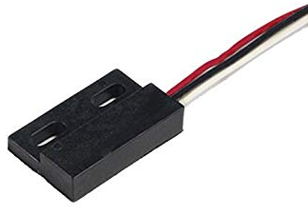
System Debug
Issue
System freezes when pumps turn on
Context
3 sensors and 2 pushbuttons use interrupt service routines (ISRs) with simple delay debounce routine
If interrupt: wait 25 ms, then check state: ISR if high, exit if low
Root Cause Analysis
Removed sensor response from logic – timing worked reliably
Added interrupts back incrementally – timing froze again with both reed switches
Possible causes: weak magnet, EMI signal noise, mechanical vibration
Solutions
Software Patches
Counter-based debounce routine to minimize time spent in ISR
Change reed switches to polling architecture rather than event-based
Hardware
Stronger magnets
Twisted-pair cabling of high amperage lines to minimize EMI
Reed switch.
About Me
Project Background
Hardware Selection
Low-Res Prototype
Functional Prototype
Looks-Like/Works-Like
Outcome

Slide 23
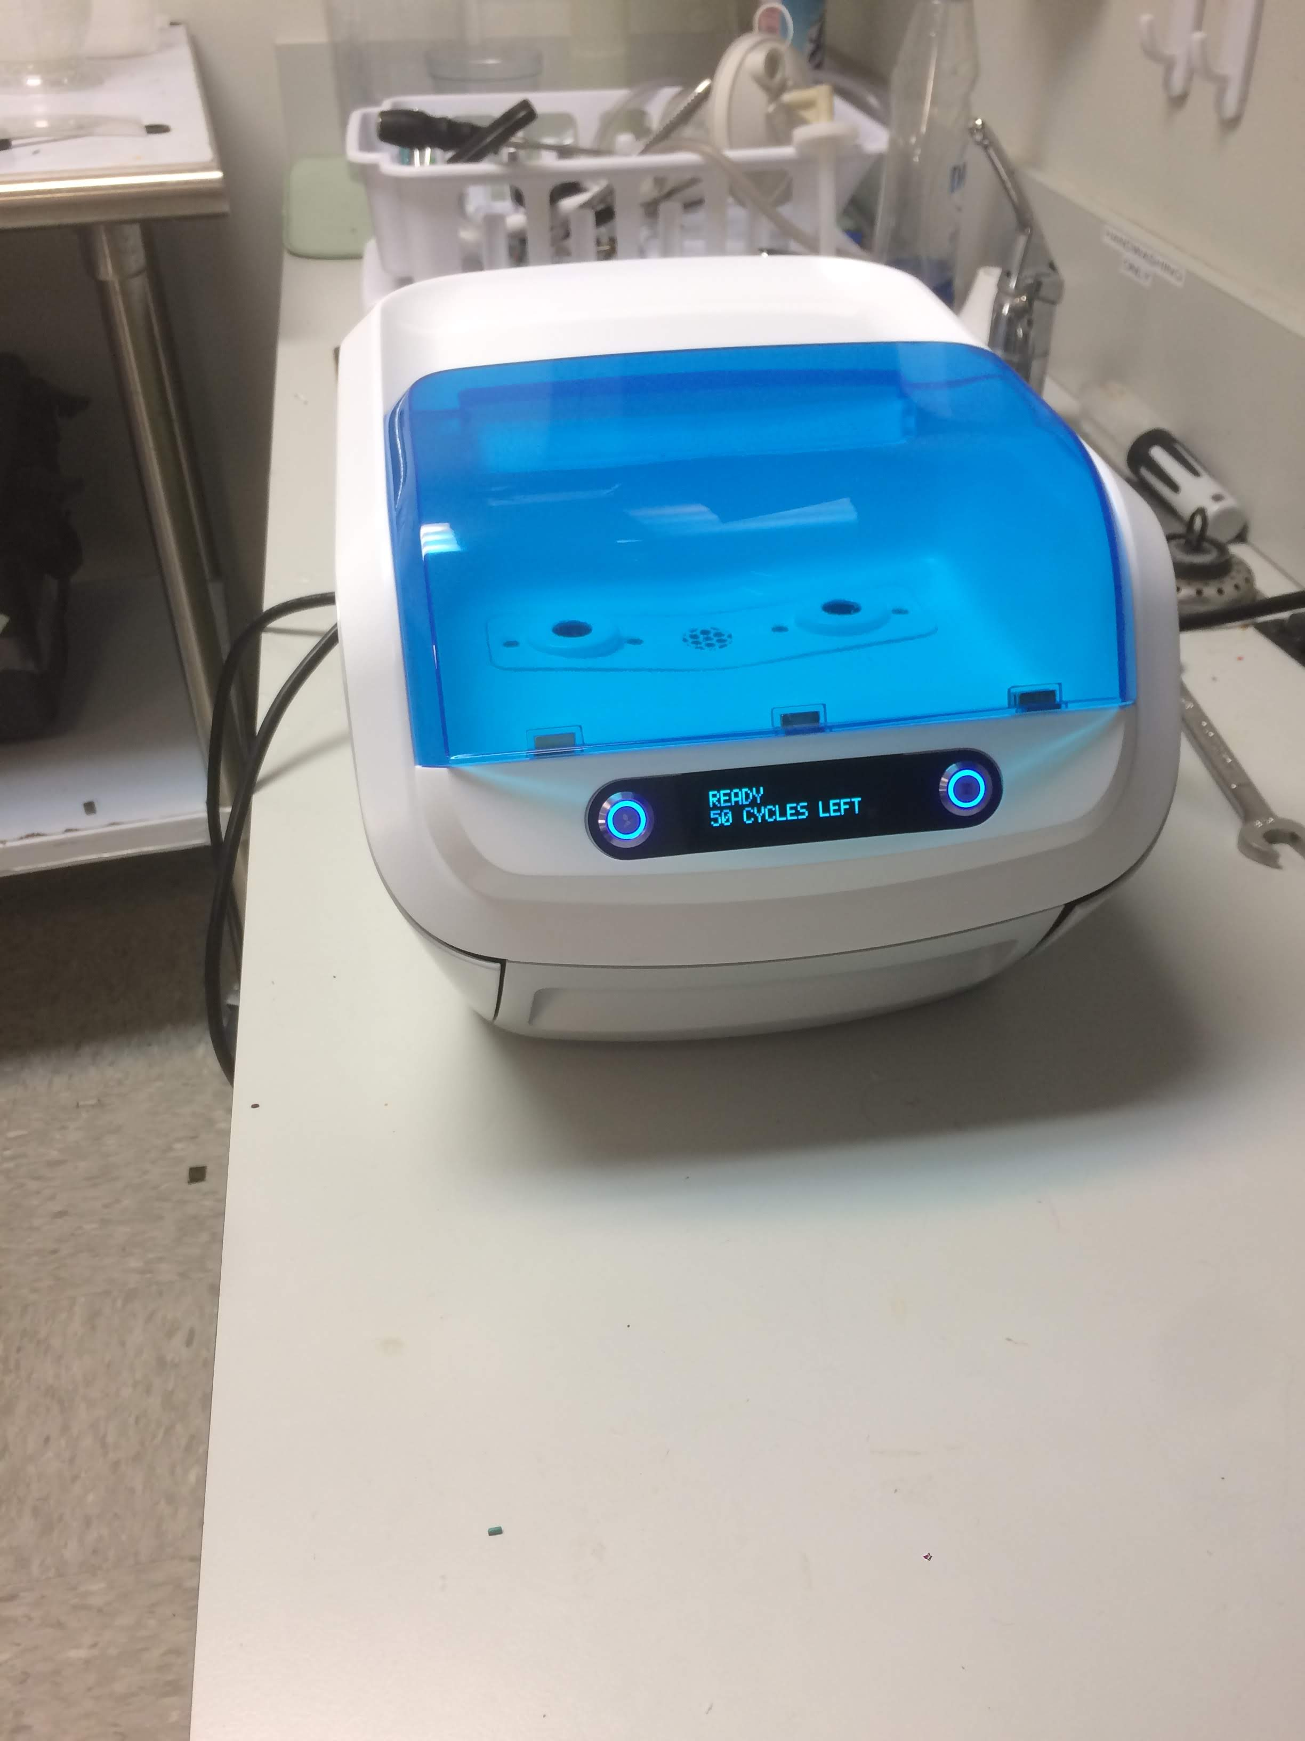
Outcome
Project
$200,000 billable project delivered on schedule
Client demoing prototype to customers since mid-Sep without issue
Client returned with 2 new projects
Personal
Owned critical components and deadlines of multidisciplinary project (ME/EE/ID)
Built tuneable controls architecture to handle every case
Systematically debugged issues to identify root cause and corresponding solution
About Me
Project Background
Hardware Selection
Low-Res Prototype
Functional Prototype
Looks-Like/Works-Like
Outcome

Slide 24
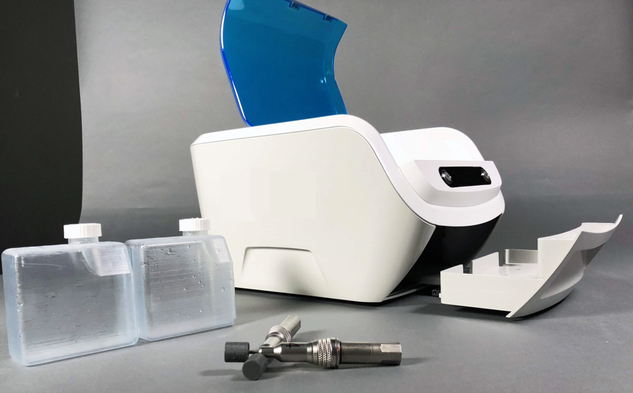
Questions?

